Slide 1
Common Ground
Protocols for Working with the K-12 Writing Samples in In Common
Student writing samples that can be used with these protocols can be found at www.achievethecore.org
Notes:
In order to help educators use In Common, the Vermont Writing Collaborative has developed several protocols that offer directions for preparing and using the student work in the collection for professional learning.

Slide 2
Common Ground Protocols
A set of activities designed to help educators and students understand the elements of an effective piece of writing as described by the Common Core Writing Standards.
Activities can be adapted to any writing type, grade level or cluster of grade levels.
Can be used with In Common or other sets of student samples .
Notes:
The Vermont writing Collaborative has created 4 different activities that can be used by teachers, administrators, and other literacy leaders to deepen understanding of what effective Common Core aligned writing might look like. Some of these activities can even be adapted to be used by students!
All of the protocols can be used at any grade level to analyze work in any of the three CCSS writing types. The Common Ground Protocols can be used with the student samples collected in In Common or with writing generated by your own students.

Slide 3
For each Common Ground Activity, you will find:
A Professional Development
Planning Page
A Protocol
A Recording Sheet
Notes:
The Protocols, available for free on achievethecore.org, each contain
a planning page, with instructions on preparing and leading the activity,
the protocol itself , which clarifies the purpose of the activity and gives directions to participants
and
some type of recording sheet for capturing learning and observations.

Slide 4
Four Protocols are available for guiding professional learning using In Common:
How Does Your Garden Grow?
Learning by Example
Colorful Language
What Can My Students Learn by Writing?
Protocols are available on achievethecore.org
Notes:
There are four protocols available, and each can be used flexibly.

Slide 5
Today we will deepen our understanding of one of the Common Core writing type using a Common Ground Activity:
Informative/Explanatory
How Does Your Garden Grow?
NOTE: This protocol can be used with any writing type.
Notes:
Change this slide if you will be exploring a different writing type.

Slide 6
How Does Your Garden Grow?
PURPOSE: To trace a developmental progression in each type of writing in the Common Core State Standards.
Notes:
The first is called “How Does Your Garden Grow?” . Much can be learned from examining student work using this protocol, but its primary purpose is to look at the developmental progression in a particular type of writing : Opinion/Argument, Informative/Explanatory or Narrative.

Slide 7
Protocol
How Does Your Garden Grow?
Overview:
In this exercise, you will compare student pieces within a grade cluster and note the similarities and differences. The pieces in your packet have been written to a set of uniform prompts purposefully designed to produce student pieces in a single writing type, on the same topic, across a range of grade levels. Analyzing these pieces can help you distill the core elements of each writing type and gain a better understanding of expectations at each grade level.
Purpose:
To identify the core elements of one type of CCSS aligned writing (Opinion/Argument, Informative/Explanatory, Narrative).
To refine and deepen understanding of grade level expectations in the CCSS .
To trace a developmental progression in one type of writing required by the Common Core State Standards.
Protocol: Note: This activity centers on observation, please do not use your copy of the Common Core Standards until the final step in the protocol.
Read the first piece in the packet. What elements of effective writing are evident in this sample? Discuss your observations with a partner.
Read the next piece. How is this piece similar to the previous piece? How is it different? Record your observations on the How Does Your Garden Grow? Record Sheet.
Continue reading, analyzing and discussing each piece. Be sure to capture your thinking on the record sheet as you work.
When you have finished, synthesize your observations by responding to the questions at the bottom of the recording sheet.
Notes:
Here’s a quick peek at the “protocol” or direction page for this activity. You can see that it includes an overview and some goals or purposes of the activity as well as specific directions.

Slide 8
Worksheet
Notes:
Pairs are given a sheet like this…

Slide 9
Informative/Explanatory
Writing
W.2 Write informative/explanatory texts to examine and convey complex ideas and information clearly and accurately through the effective selection, organization, and analysis of content.
Notes:
Replace this slide if you are working with a different writing type.

Slide 10
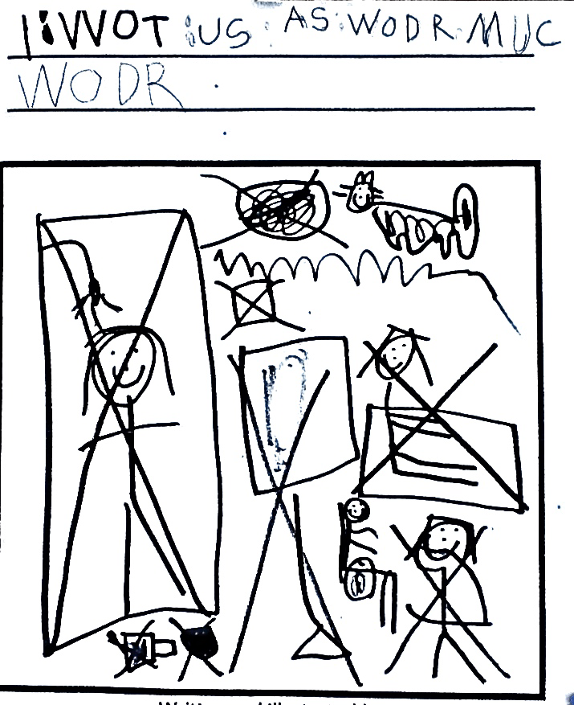
Analyze a sequence of work written to the same focusing question.
What effect did the Great Depression have on people who lived through it?
6-12
Gains of the Great Depression
During the Great Depression, millions of people lost jobs, and families struggled to find financial footholds. It lasted for ten years, leaving very strong memories of dramatically dark times. ..
OR
What can you do to save water?
K-5
Notes:
This activity uses the sequence of student work written around the same topic that Joey discussed earlier. Participants can work with either a K-5 sequence or a 6-12 sequence. In Common contains similar progressions in Opinion/Argument Writing and Narrative Writing. So this activity can be used to understand any of the 3 Common Core writing types.

Slide 11
Look for growth in student samples…
Kindergarten, Fall
On Demand Writing- Uniform Prompt
Water
I WOT US AS WODR MUC WODR
Kindergarten, Spring
On-Demand Writing, Uniform Prompt
Saving Water
What can you do to save water?
I am taking a baf Not all faLL.
I amsHuting off the wotr
I am filing the bucit up Not too Hiy
Grade 1
On Demand Writing- Uniform Prompt
Saving Water
What can you do to save water?
we need to save water! To save water do not fill up the tub all the way. if your fawsit is leking turn it of. if we didint save water we woldent have any.
Notes:
In “How Does Your Garden Grow?” participants work in pairs to note similarities and differences in student pieces across grade levels. Because all of the pieces are written to the same focusing question, it is much easier to see growth as students move up through grade levels. Similarities also become apparent, allowing educators to firmly understand the “core” qualities of each writing type. Participants completing this activity essentially derive the standards themselves through an analysis of student work across grade levels.

Slide 12
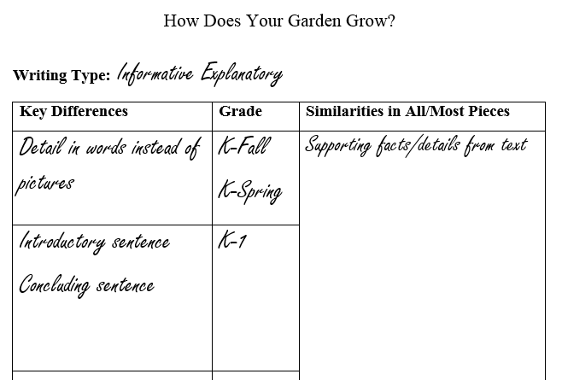
Record Observations…
Notes:
on which to record observations.

Slide 13
How Does Your Garden Grow?
Protocol: Note: This activity centers on observation, please do not use your copy of the Common Core Standards until the final step in the protocol.
Read the first piece in the packet. What elements of effective writing are evident in this sample? Discuss your observations with a partner.
Read the next piece. How is this piece similar to the previous piece? How is it different? Record your observations on the How Does Your Garden Grow? Record Sheet.
Continue reading, analyzing and discussing each piece. Be sure to capture your thinking on the record sheet as you work.
When you have finished, synthesize your observations by responding to the questions at the bottom of the recording sheet.

Slide 14
How Does Your Garden Grow?
Reflect…
What did you learn about the Informative/Explanatory writing standard
(W.2) that you didn’t know before?
How might this activity be useful in your school?
Notes:
Reflection questions at the end encourage synthesis and provide an opportunity for full group discussion.

