Slide 1
ELA AGENDA
TUESDAY
11/12
AM= 9:09-10:41
PM= 1:24- 3:00
Attendance/ Pass out Writer’s Notebooks
Writer’s Notebook= Word Work & Art Analysis (table talk)
Media Analysis of Mind the Gap (independent- assigned groups)
Read informational article Stereotypes and the Older Worker
Read the article and underline key ideas.
Discuss and respond to the guiding questions.
Be ready to defend all of your thinking with evidence.
Sharing & Closure

Slide 2
Word Work
old age sticks
up Keep
Off
signs)&
youth yanks them
down(old
age
cries No
Tres)&(pas)
youth laughs
(sing
old age
scolds Forbid
den Stop
Must
n't Don't
&)youth goes
right on
gr
owing old
Last week we read the poem “Old Age Sticks” by e.e. cummings. What are some ways that the old and young debase one another in this poem?
Look at the painting, para siempre, by Octavio Ocampo. Using details from the painting, explain what you think the artist is saying about “the old.”

Slide 3
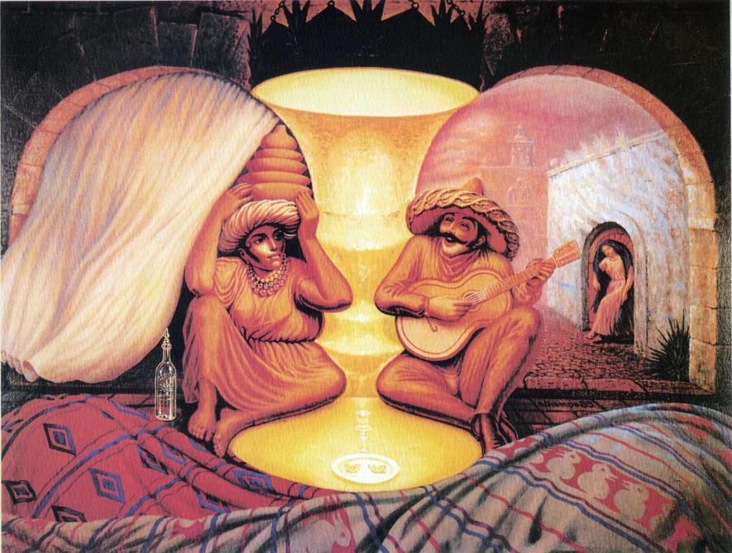
Using details from the painting, explain what you think the artist is saying about “the old.”

Slide 4
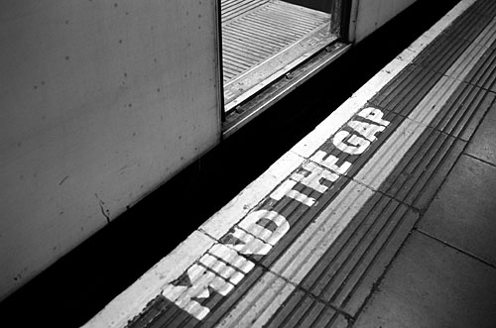
“Mind the Gap” is an expression used to warn railway passengers to be careful when crossing over the space between the train and the station platform. It was originally introduced on the London Underground in the late 1960’s.
In 2011 the Assisted Living Organization of America (ALFA), sponsored a short film competition to help make the larger community aware of the stereotypes related to ageism. The winner of the competition was a film entitled “Mind the Gap.” Watch this film and consider the following critical viewing question:
Using evidence from the film, explain why you think the creators of this piece would use the warning “Mind the Gap” as their title.
http://www.alfa.org/alfa/Mind_the_Gap_Film.asp

