Slide 1
Grade 6: Alignment to Mathematics Grade-Level Standards
Notes:
This module was last updated on January 2017.
Over the past several years, we have seen several changes in states K-12 assessment systems as states work (sometimes collaboratively) to design assessment systems that provide information on students’ progress toward college and career readiness in mathematics and English language arts. For many states, this was a major change from previous assessments, which were largely characterized by multiple-choice items that were not reflective of the comprehensive set of skills defined by college-and-career ready standards.
The goal of this module is to provide guidance on grade 6 item development and alignment, highlighting the Council of Chief State School Officers Criteria for High-Quality Assessments and the collective experiences of the assessment consortia and individual states throughout their multi-year assessment design processes.

Slide 2
Session Objective
The purpose of these materials is to help develop understanding of the expectations of high-quality summative assessment items. The concepts shown throughout these modules can be useful for classroom questioning and assessment, but the items themselves may need to be slightly modified.

Slide 3
CCSSO Section C: Align to Standards – Mathematics
Criterion C.1: Focusing strongly on the content most
needed for success in later
mathematics
Criterion C.2: Assessing a balance of concepts, procedures, and applications
Criterion C.3: Connecting practice to content
Criterion C.4: Requiring a range of cognitive demand
Criterion C.5: Ensuring high-quality items and a
variety of item types
Notes:
Based on the need to provide guidance for what high-quality assessments looked like, the Council of Chief State School Officers created the Criteria for Procuring and Evaluating High-Quality Assessments. More information on this document can be found in the “Test Level Considerations” presentation for Mathematics. The full document is also available online. http://ccsso.org/News_and_Events/Press_Releases/State_Chiefs_Release_Criteria_for_High-Quality_Assessment.html
In 2013, CCSSO worked with their stakeholders, the Chief State School Officers, to draft principles of high-quality assessments. These principles described the characteristics of high-quality assessments aligned to college and career readiness. Through the end of 2013 and into 2014, CCSSO continued working with their stakeholders to clarify what these principles mean. The principles became criteria with metrics used to judge whether these principles were realized in assessment systems. These are the criteria on which this review of assessment systems will be based.
There are six sections of the CCSSO Criteria. Overarching goals and technical quality (e.g., accessibility, validity, and reliability) come first. Then two sections on content alignment. Then reports, administration, and a section where states can add criteria reflecting individual state needs. The overall document is designed to be “drop in” for a state’s RFP and can be modified as needed. It could also could serve as a “drop in” checklist of criteria for evaluating an existing assessment. For the purpose of this module, we will focus on Section C: Align to Standards – Mathematics. The slide shows the five content alignment criteria in Section C of the CCSSO document, which is the section covering mathematics.
College and career readiness has specific implications for math content, math instruction, and therefore, math assessment. We are not talking about just *any* mathematics, by the way, but mathematics that aims at college and career readiness. States require assessments that match the depth, breadth, and rigor of the standards, accurately measure student progress towards college and career readiness, and provide valid data to inform teaching and learning.

Slide 4
Notes:
Criteria 1 emphasizes the content most needed for success in later mathematics. Throughout this presentation, this will be referred to as “major work of the grade” or just “major work.” This table shows the grade 6 content clusters classified as Major, Supporting, and Additional.
Major Clusters coherently capture the emphases at each grade; Supporting Clusters have natural connections to Major Clusters; and Additional Clusters stand well on their own, with weaker natural connections to the Major Clusters. PARCC, Smarter Balanced, and several states working independently on developing aligned assessments used these designations to inform the proportional representation of content reflected in their summative test blueprints.
It is also worth pointing out that the structure of the standards organized by domain, then by cluster, reveal things that are different in these standards than states’ previous standards. For example, there has never been a standards document before that uses Ratios and Proportional Relationships as a top-level organizer; the fact that CCSS uses it as a top-level organizer signals its emphasis in the document. In general, standards that are college and career ready based on evidence will drive towards a substantial amount of algebra for all students during middle school. The major work designations trace that trajectory.

Slide 5
Ten Principles of CCSS-Aligned Items
1. Most items aligned to standards in supporting clusters connect to the major work of the grade.
2. Items are designed to address the aspect(s) of rigor (conceptual understanding, procedural skill, and application) evident in the language of the content standards.
3. Items are designed to attend to content limits articulated in the standards.
4. Most items aligned to a single content standard should assess the central concern of the standard.
5. Representations are well suited to the mathematics that students are learning and serve an important purpose within the item itself.
6. Items use mathematically precise language, are free from mathematical errors or ambiguities, and are aligned to the mathematically appropriate standard.
7. The demands of items measuring the Standards for Mathematical Practice are appropriate to the targeted grade level.
8. Item types are chosen to match the item’s purpose and as part of the evidence required by the standards.
9. Most items measuring the Standards for Mathematical Practice are also aligned to content standards representing the major work of the grade.
10. Items written at the cluster or domain level measure key integration points not necessarily articulated in individual standards but plausibly implied directly by what is written.
Notes:
Here are ten principles that can be used to guide the creation of CCSS-aligned assessment items. This list was generated based on common issues identified by the assessment consortia as well as individual states as they worked to develop next-generation assessment systems. You will also note connections back to the CCSSO criteria. For example, alignment principles 1 and 9 are used to support Criterion 1, focusing strongly on the content needed for success in later mathematics. Note that these two also use the phrase “major work of the grade” as defined in the previous slide. As another example, Principle 2 is directly tied to Criterion 2, assessing a balance of concepts, procedures, and applications.
Each principle will be illustrated through examples selected from publicly available sources or created by Student Achievement Partners content staff.

Slide 6
Alignment Principle #1
Most items aligned to standards in supporting
clusters connect to the major work of the grade.
Notes:
The word “supporting” that is used to describe a subset of the K-8 Common Core State Standards for Mathematics signals that these standards are well connected to the content representing the major work of the grade. Many of the standards in the Measurement & Data domain, for example, require students to solve problems based on the grade-level work in the Operations & Algebraic Thinking and the Number & Operations – Fractions domains. These connections reinforce the important work in grades K-8, allowing students to engage deeply with the content instead of seeing mathematics as a set of discrete topics.

Slide 7
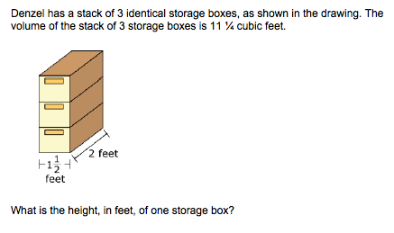
Most items aligned to standards in supporting clusters connect to the major work of the grade.
6.G.A.2. Apply the formulas V=lwh and V=Bh to find volumes of right rectangular prisms with fractional edge lengths in the context of solving real-world and mathematical problems. [standard intentionally shortened to fit slide]
Notes:
© Item adapted from the PARCC Grade 6 EOY Test. Available from https://prc.parcconline.org/assessments/parcc-released-items; accessed April 2016.
Let’s look at this example item written to illustrate Alignment Principle 1.
Answer key: 1 ¼, or equivalent
What makes this item a good illustration of Alignment Principle 1?
The primary standards alignment for this item is the to 6.G.A.2, a supporting standard in the geometry domain. The major work of grade 6 on dividing fractions (6.NS.A.1) is a key part of the problem-solving strategy needed to answer this volume problem; this item is a good illustration of the alignment principle showing how developers should use opportunities to connect to major work for standards labeled as supporting. Students may also draw on knowledge and skills acquired as part of their work in the Expressions and Equations domain as an approach to this problem given the formulas used and the unknowns they are asked to find.

Slide 8
Alignment Principle #2
Items are designed to address the aspect(s) of rigor (conceptual understanding, procedural skill, and application) evident in the language of the content standards.
Notes:
The language used in the standards provides information about which aspects of rigor should be targeted in items written for those standards. Words and phrases like “extend previous understandings,” “fluently multiply,” and “solve” signal a need for items that measure conceptual understanding, procedural skill, and application, respectively. The following slides provide examples of grade 6 items, the standards to which they are written, and the key words signaling the aspects of rigor.

Slide 9
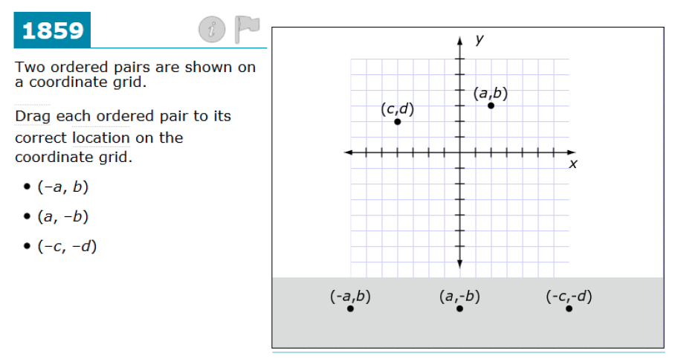
Items are designed to address the component(s) of rigor (conceptual understanding, procedural skill, and application) evident in the language of the content standards.
6.NS.C.6b. Understand signs of numbers in ordered pairs as indicating locations in quadrants of the coordinate plane; recognize that when two ordered pairs differ only by signs, the locations of the points are related by reflections across one or both axes.
Notes:
© Item retrieved from the Smarter Balanced 2015 Grade 6 Practice Test. Available from http://www.smarterbalanced.org/assessments/; accessed April 2016.
Let’s look at this example item written to illustrate Alignment Principle 2.
Answer key: Student drags each ordered pair to its correct location on the coordinate grid.
What makes this item a good illustration of Alignment Principle 2?
This item also measures conceptual understanding, this time showing the work of the NS domain. The item author nicely embodies the language of this particular standard, choosing to use variables instead of numbers for the ordered pairs to ensure that the conceptual understanding required by the standard is targeted.

Slide 10
Items are designed to address the aspect(s) of rigor (conceptual understanding, procedural skill, and application) evident in the language of the content standards.
Enter the unknown value that makes this statement true:
45 is ____% of 50.
6.RP.A.3c. Find a percent of a quantity as a rate per 100 (e.g., 30% of a quantity means 30/100 times the quantity); solve problems involving finding the whole, given a part and the percent.
Notes:
© Item retrieved from the Smarter Balanced Grade 6 Claim 1 Item Specifications. Available from http://www.smarterbalanced.org/assessments/; accessed April 2016.
Let’s look at this example item written to illustrate Alignment Principle 2.
Answer key: 90
What makes this item a good illustration of Alignment Principle 2?
There is plenty of room in the grade 6 assessment for straightforward percent problems. This work combined with some simple applications will ensure that students have the foundation for the rich applications that will be expected in grade 7 and beyond.

Slide 11
Items are designed to address the aspect(s) of rigor (conceptual understanding, procedural skill, and application) evident in the language of the content standards.
Alan is making banana bread. The ratio of the number of cups of mashed bananas to the number of cups of flour for his recipe is 6:3.
Alan uses 3 cups of mashed bananas to make 1 loaf. How many cups of flour will he use?
Erik uses Alan’s recipe to make banana bread. Erik uses 9 cups of flour in total. How many loaves does Erik make?
6.RP.A.3. Use ratio and rate reasoning to solve real-world and mathematical problems, e.g., by reasoning about tables of equivalent ratios, tape diagrams, double number line diagrams, or equations.
Notes:
Let’s look at this example item written to illustrate Alignment Principle 2.
Answer key: 1.5, or equivalent; 6
What makes this item a good illustration of Alignment Principle 2?
This item successfully illustrates the application demand of standard 6.RP.A.3, which asks students to solve real-world and mathematical problems. For developers wishing to reduce within-item dependency, the item can be easily modified in a couple of ways: administer only part (a) or move the necessary information from part (a) to the item stem and ask only part (b).

Slide 12
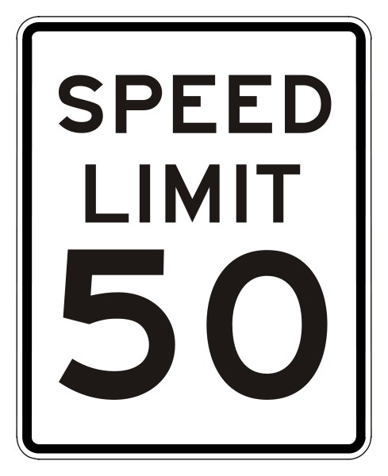
Alignment Principle #3
Items are designed to attend to content limits articulated in the standards.
Notes:
Content limits are often established at the grade level, so it is essential that item writers know and understand the content standards for the entire grade level, not just a single standard for which they may be authoring items. Operations & Algebraic Thinking, Number & Operations in Base Ten, and Number & Operations – Fractions domains all have specific content limits that must be attended to even in items where the direct target of measurement is in a different domain. For example, if students are solving two-step word problems using the four operations in grade 3, and one of the steps happens to be addition, it is important to pay attention to the ceiling established in NBT for addition even though the item will be aligned to the standard in OA.

Slide 13
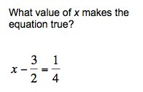
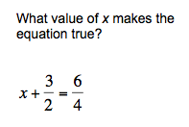
Items are designed to attend to content limits articulated in the standards.
6.EE.B.7. Solve real-world and mathematical problems by writing and solving equations of the form x + p = q and px = q for cases in which p, q and x are all nonnegative rational numbers.
Notes:
Let’s look at this example item written to illustrate Alignment Principle 3.
Answer key: 7/4; 0
What makes this item a good illustration of Alignment Principle 3?
Standard 6.EE.B.7 establishes a ceiling for the allowable values used in writing and solving equations in grade 6. To stay within the content limits, it is critical that item writers read the standard very carefully. While the NS domain develops an initial understanding of negative numbers in grade 6, operations are not the focus until grade 7 making this content limit in grade 6 an important one for attending to the within-grade coherence.

Slide 14
Alignment Principle #4
Most items aligned to a single content standard should assess the central concern of the standard.
Notes:
Covering the “breadth” of a standard has often meant attending to every noun, verb, and strategy articulated in the standard and breaking it down into very fine-grained, measurable outcomes. So it is common for item authors to look at the “e.g.” portion of the standard and write items that measure each example given. Often these examples illustrate strategies that are useful as part of teaching and learning to help students become mathematically proficient. Items should be designed in such a way that make certain strategies more efficient and/or appealing when such strategies are articulated. However, summative assessments are designed to measure what students have learned and less how they learned it; therefore, we want the items to measure the core desired outcome of the standard, not merely emphasize the choice of strategy.

Slide 15
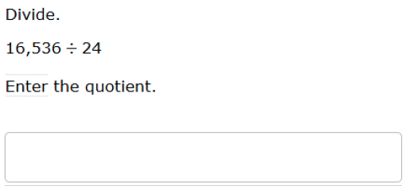
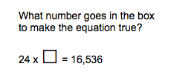
Most items aligned to a single content standard should assess the central concern of the standard.
Central Concern
Not the Central Concern
6.NS.B.2. Fluently divide multi-digit numbers using the standard algorithm.
Notes:
© Item retrieved from the PARCC Grade 6 EOY Test. Available from https://prc.parcconline.org/assessments/parcc-released-items; accessed April 2016.
Let’s look at this example item written to illustrate Alignment Principle 4.
Answer key: 689; 689
What makes this item a good illustration of Alignment Principle 4?
The grade 6 standard 6.NS.B.2 is very specifically about fluency with multi-digit division. Therefore, most items within an assessment measuring 6.NS.B.2 should ask students to divide. Problems like the one on the right are more appropriate for previous grades where students are developing strategies for division and would likely benefit from friendlier numbers where viewing division through the lens of multiplication might make sense.

Slide 16
Alignment Principle #5
Representations are well suited to the mathematics that students are learning and serve an important purpose within the item itself.
Notes:
Representations, such as number lines and area models, should be well connected to the mathematics that students are learning and serve an important purpose within the item itself.
When developing an item an item writer should ask: “Is there something mathematically important about including this representation?” If the answer is “Yes,” then the item writer should proceed. The next question the item writer must ask when developing an item should be: “Is the representation giving the appearance of a particular solution path even though other strategies are viable and likely?” The answer to this question should be “No.” Answering these questions will help an item writer decide whether to include a particular representation.

Slide 17
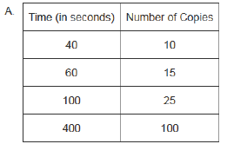
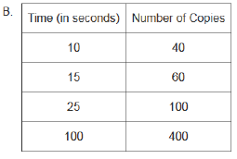
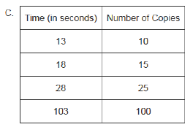
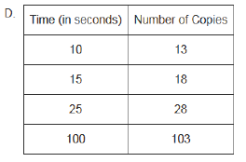
Representations are well suited to the mathematics that students are learning and serve an important purpose within the item itself.
The diagram shows the unit rate for making copies on a copy machine.
Which table shows data for the same copy machine?
6.RP.A.3. Use ratio and rate reasoning to solve real-world and mathematical problems, e.g., by reasoning about tables of equivalent ratios, tape diagrams, double number line diagrams, or equations.
Notes:
© Item adapted from the PARCC Grade 6 EOY Test. Available from https://prc.parcconline.org/assessments/parcc-released-items; accessed April 2016.
Let’s look at this example item written to illustrate Alignment Principle 5.
Answer key: B
What makes this item a good illustration of Alignment Principle 5?
The RP domain is an important place to help students make meaning by connecting across representations. The simplicity of this item is nice in that most of the work that students need to do is to associate the double number line with the table containing data that matches the indicated rate. By making problems that are almost entirely grounded in mathematical representations, we can focus exclusively on the desired mathematics and reduce the linguistic complexity of items in this domain. Test developers should be thoughtful about which representations are selected and used in student assessments—having too many representations may have the unintended consequence of detracting from the core mathematics that students are learning. With this item, we have elected to illustrate representations specifically mentioned in the standard.

Slide 18
Alignment Principle #6
Items use mathematically precise language, are free from mathematical errors or ambiguities, and are aligned to the mathematically appropriate standard.
Notes:
This alignment principle covers a range of issues related to the mathematical and technical quality of items, from using “least” instead of “fewest,” to failing to adequately specify what is meant by “one cubic unit” in a visual image. This is one of the more challenging aspects to train writers and reviewers on due to the type of specific content knowledge needed to successfully identify issues. Incorporating mathematicians into review processes for at least a subset of the total development can provide some assurance that this principle is being well attended to by item authors and/or reviewers.

Slide 19
Items use mathematically precise language, are free from mathematical errors or ambiguities, and are aligned to the mathematically appropriate standard.
✗
Wyatt hiked 6 miles in 2 hours. How many miles can he hike in 9 hours?
✔
Wyatt hiked 6 miles in 2 hours. At this same rate, what is the total number of miles he would hike in 9 hours?
6.RP.A.3 Use ratio and rate reasoning to solve real-world and mathematical problems, e.g., by reasoning about tables of equivalent ratios, tape diagrams, double number line diagrams, or equations.
Notes:
Let’s look at this example item written to illustrate Alignment Principle 6.
Answer key: 27
What makes this item a poor illustration of Alignment Principle 6?
With rate problems, it is a common issue to want the item respondent to make assumptions of same rate in applying a given rate. However, it is best practice to state this assumption within the question to remove any ambiguity and avoid arguments of other plausible responses. In reality, we rarely do anything at a constant rate, so making it very clear in these kinds of problems that the same rate is assumed is an important clarification. The addition of the word “total” in the second version of this item further reduces ambiguity and strengthens the clarity of what is being asked for in the student response.

Slide 20
Alignment Principle #7
The demands of items measuring the Standards for Mathematical Practice are appropriate to the targeted grade level.
Notes:
The Standards for Mathematical Practice should reflect a growing arc of sophistication in assessment items. In early grades, students might give examples or non-examples to show their understanding of a particular claim, but are not asked to prove it or show that it is true for all cases. Similarly, younger students begin modeling real-world situations with equations, but do not engage in the full modeling cycle shown in the high school standards.

Slide 21
The demands of items measuring the Standards for Mathematical Practice are appropriate to the targeted grade level.
MP1. Make sense of problems and persevere in solving them.
6.G.A Solve real-world and mathematical problems involving area, surface area, and volume.
Notes:
© Item adapted from the PARCC Grade 6 EOY Test. Available from https://prc.parcconline.org/assessments/parcc-released-items; accessed April 2016.
Let’s look at this example item written to illustrate Alignment Principle 7.
Answer key: 51 ¾, or equivalent
What makes this item a good illustration of Alignment Principle 7?
This problem is a good example of MP1 in grade 6. Unlike straightforward volume problems where students simply multiply length times width times height, this problem requires that students interpret the meaning of that product (if this is the method they choose) and then do further work to determine the volume of the prism. Students may choose to convert the edge lengths first from number of cubes to inches and then determine the volume. Since this problem looks like the more familiar “compute the volume” type of problem, it is a good one for highlighting the first part of MP1 requiring students to first make sense of the problem.

Slide 22
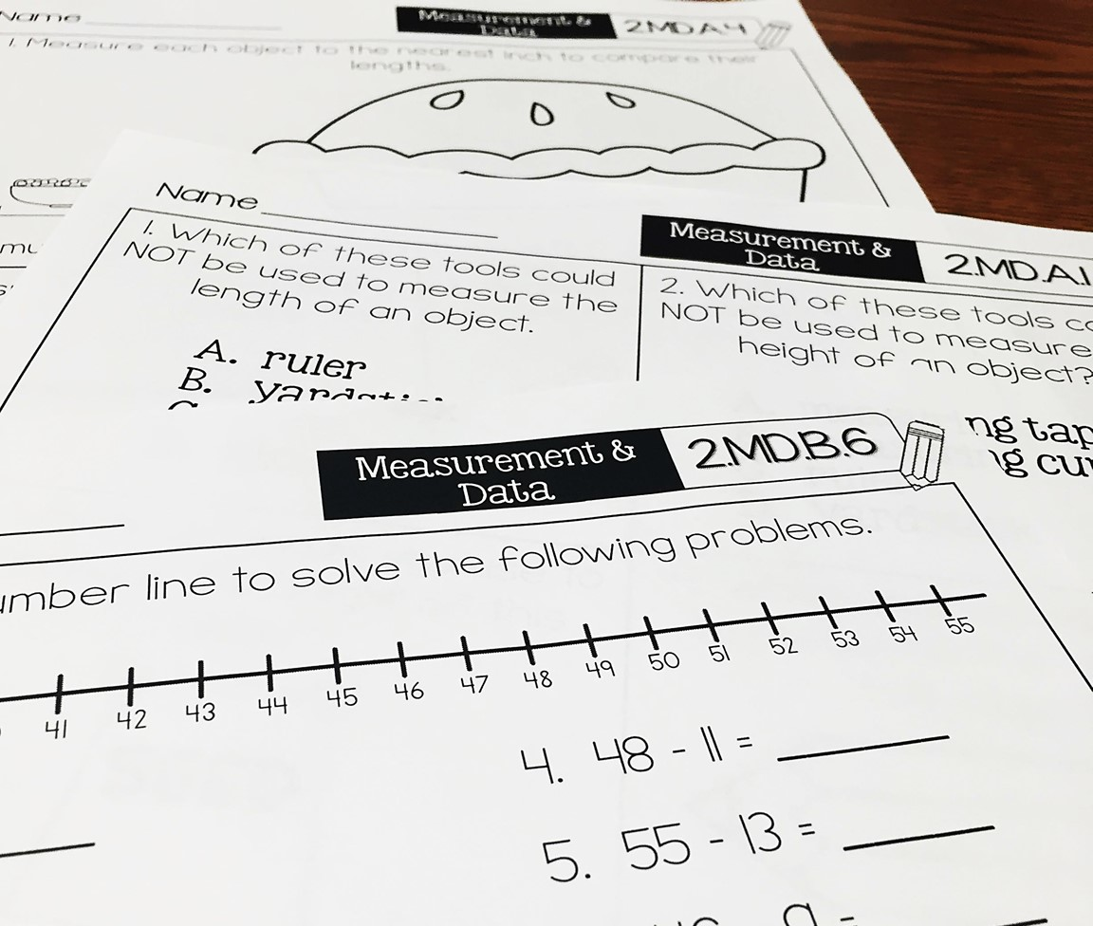
Alignment Principle #8
Item types are chosen to match the item’s purpose and as part of the evidence required by the standards.
Notes:
With many assessments moving online, choices of item type have a lot of driving factors: accessibility, cost, and content. In this section, we will show examples of items that are designed well to meet the evidence required by the standards and are well suited to a particular item’s purpose. This is not to say that a balanced assessment that meets the demands of the standards must include all of these item types nor that this is an exhaustive list of available item types, but that an aligned assessment will include multiple item types. These are illustrations of good ways to collect the evidence required by the standards, but decisions ultimately must be made after carefully considering how to effectively balance cost, content, and accessibility.

Slide 23
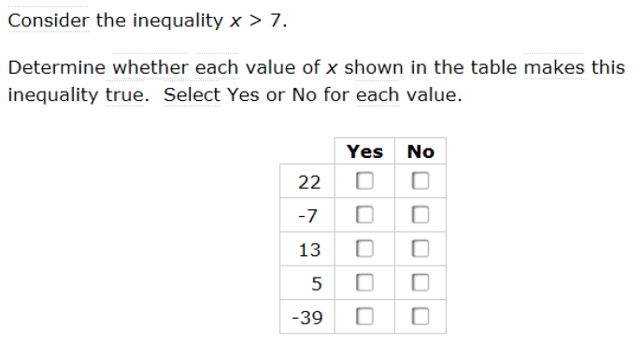
Item types are chosen to match the item’s purpose and as part of the evidence required by the standards.
6.EE.5. Understand solving an equation or inequality as a process of answering a question: which values from a specified set, if any, make the equation or inequality true? Use substitution to determine whether a given number in a specified set makes an equation or inequality true.
Notes:
© Item retrieved from the Smarter Balanced 2015 Grade 6 Practice Test. Available from http://www.smarterbalanced.org/assessments/; accessed April 2016
Let’s look at this example item written to illustrate Alignment Principle 8.
Answer key: 22 Y; -7 N; 13 Y; 5 N; -39 N
What makes this item a good illustration of Alignment Principle 8?
This item type, sometimes called “matching tables,” works particularly well with standard 6.EE.5 because of the requirement for students to evaluate a set of values. Depending on the available item types for a particular program, this could also be deployed as a selected-response item where students are allowed to select more than one value.

Slide 24
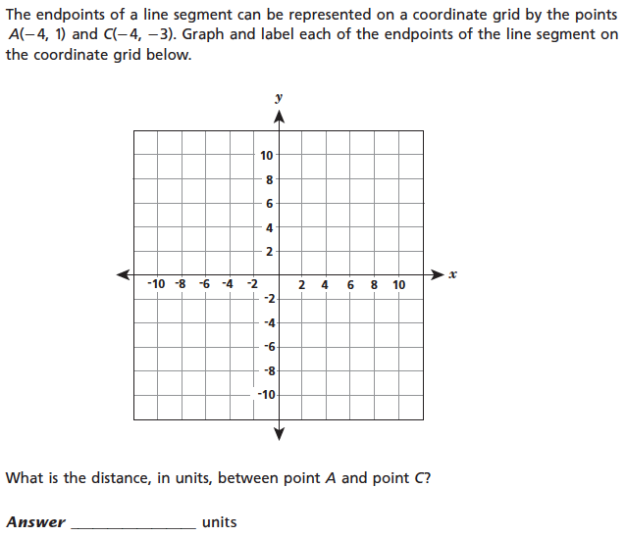
Item types are chosen to match the item’s purpose and as part of the evidence required by the standards.
6.NS.C.8. Solve real-world and mathematical problems by graphing points in all four quadrants of the coordinate plane. Include use of coordinates and absolute value to find distances between points with the same first coordinate or the same second coordinate.
Notes:
© Item retrieved from EngageNY.org of the New York State Education Department. 2015 Grade 6 Mathematics Test Released Questions. Internet. Available from https://www.engageny.org/resource/released-2015-3-8-ela-and-mathematics-state-test-questions; accessed April 15, 2016.
Let’s look at this example item written to illustrate Alignment Principle 8.
Answer key: Student plots the two points and records the distance as 4 units.
What makes this item a good illustration of Alignment Principle 8?
Although this item comes from a paper-based test, the online equivalent would look pretty comparable. Having some kind of graphing functionality as part of the repertoire of item types ensures that the standards in grades 6 and up can be measured with greater fidelity.

Slide 25
Item types are chosen to match the item’s purpose and as part of the evidence required by the standards.
6.RP.A.3.d. Use ratio reasoning to convert measurement units; manipulate and transform units appropriately when multiplying or dividing quantities.
Notes:
© Item retrieved from EngageNY.org of the New York State Education Department. 2015 Grade 6 Mathematics Test Released Questions. Internet. Available from https://www.engageny.org/resource/released-2015-3-8-ela-and-mathematics-state-test-questions; accessed April 15, 2016.
Let’s look at this example item written to illustrate Alignment Principle 8.
Answer key: C
What makes this item a good illustration of Alignment Principle 8?
Where it is important to limit the response options to achieve the purpose of the item, multiple choice works quite well. In this particular item, the author wanted a particular expression to be selected to highlight the relationship between the 30 seconds given in the problem and the desired unit of “feet per minute.”

Slide 26
Alignment Principle #9
Most items measuring the Standards for Mathematical Practice are also aligned to content standards representing the major work of the grade.
Notes:
Keeping the assessment focused on the major work of the grade is an important design principle in the overall test construction. In measuring the Standards for Mathematical Practice, it is important to help retain the focus of the test by using many items that align to the major work of the grade.

Slide 27
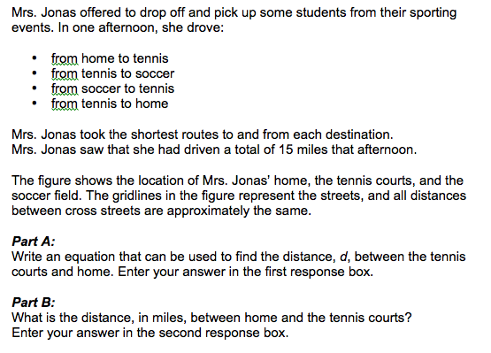
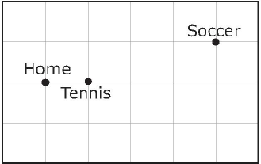
Most items measuring the Standards for Mathematical Practice are also aligned to content standards representing the major work of the grade.
MP4. Model with
mathematics.
6.EE.B.7. Solve real-world and mathematical problems by writing and solving equations of the form x + p = q and px = q for cases in which p, q and x are all nonnegative rational numbers.
Notes:
© Item adapted from the Smarter Balanced 2015 Grade 6 Practice Test. Available from http://www.smarterbalanced.org/assessments/; accessed April 2016.
Let’s look at this example item written to illustrate Alignment Principle 9.
Answer key: d+4d+4d+d=15, or equivalent; 1.5
What makes this item a good illustration of Alignment Principle 9?
This item illustrates an important, grade-appropriate connection between MP4 (Model with mathematics) and the major work of grade 6 requiring students to write and solve simple equations. This alignment principle reminds us that the Standards for Mathematical Practice should not be assessed separately from the grade-level content and allow us opportunities to ensure that assessment items span the full breadth intended by standards labeled as major work of the grade.

Slide 28
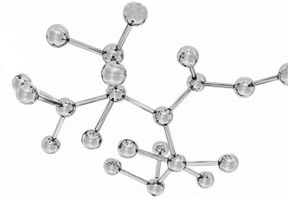
Alignment Principle #10
Items written at the cluster or domain level measure key integration points not necessarily articulated in individual standards but plausibly implied directly by what is written.
Notes:
A few items per test event may serve as opportunities to connect content across standards, domains, or grade levels. These opportunities should be carefully defined with an established purpose tied back to the language and structure of the standards. An item writer might ask: What key connections are students being asked to make to respond to this question that isn’t articulated in any individual standard?

Slide 29
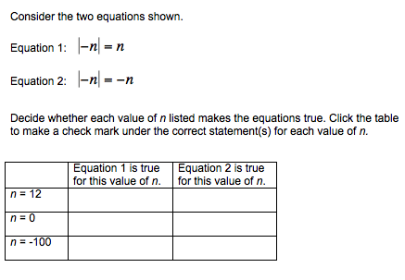
Items written at the cluster or domain level measure key integration points not necessarily articulated in individual standards but plausibly implied directly by what is written.
6.NS.C. Apply and extend previous understandings of numbers to the system of rational numbers.
Notes:
© Item adapted from the Smarter Balanced Grade 6 Claim 3 Item Specifications. Available from http://www.smarterbalanced.org/assessments/; accessed April 2016.
Let’s look at this example item written to illustrate Alignment Principle 10.
Answer key: For n=12, student selects only Equation 1; For n=0, student selects both Equation 1 & Equation 2; For n=-100, student selects only Equation 2
What makes this item a good illustration of Alignment Principle 10?
This item requires a deep understanding of multiple standards in the grade 6 NS domain (in this particular case, in addition to the cluster level 6.NS.C shown, a strong grasp of 6.NS.C.6a and 6.NS.C.7d is needed). Although it likely carries a higher difficulty parameter than an item written to a single standard in the domain, the item gives valuable information on students’ ability to integrate learning across standards.

Slide 30
Ten Principles of CCSS-Aligned Items
1. Most items aligned to standards in supporting clusters connect to the major work of the grade.
2. Items are designed to address the aspect(s) of rigor (conceptual understanding, procedural skill, and application) evident in the language of the content standards.
3. Items are designed to attend to content limits articulated in the standards.
4. Most items aligned to a single content standard should assess the central concern of the standard.
5. Representations are well suited to the mathematics that students are learning and serve an important purpose within the item itself.
6. Items use mathematically precise language, are free from mathematical errors or ambiguities, and are aligned to the mathematically appropriate standard.
7. The demands of items measuring the Standards for Mathematical Practice are appropriate to the targeted grade level.
8. Item types are chosen to match the item’s purpose and as part of the evidence required by the standards.
9. Most items measuring the Standards for Mathematical Practice are also aligned to content standards representing the major work of the grade.
10. Items written at the cluster or domain level measure key integration points not necessarily articulated in individual standards but plausibly implied directly by what is written.
Notes:
The principles illustrated throughout this module are intended to support those charged with developing summative mathematics assessment items and to support training efforts for those who review the content of items.

Slide 31
Thank You!

