Slide 1
Grade 7: Alignment to Mathematics Grade-Level Standards
Notes:
This module was last updated on January 2017.
Over the past several years, we have seen several changes in states K-12 assessment systems as states work (sometimes collaboratively) to design assessment systems that provide information on students’ progress toward college and career readiness in mathematics and English language arts. For many states, this was a major change from previous assessments, which were largely characterized by multiple-choice items that were not reflective of the comprehensive set of skills defined by college-and-career ready standards.
The goal of this module is to provide guidance on grade 7 item development and alignment, highlighting the Council of Chief State School Officers Criteria for High-Quality Assessments and the collective experiences of the assessment consortia and individual states throughout their multi-year assessment design processes.

Slide 2
Session Objective
The purpose of these materials is to help develop understanding of the expectations of high-quality summative assessment items. The concepts shown throughout these modules can be useful for classroom questioning and assessment, but the items themselves may need to be slightly modified.

Slide 3
CCSSO Section C: Align to Standards – Mathematics
Criterion C.1: Focusing strongly on the content most
needed for success in later
mathematics
Criterion C.2: Assessing a balance of concepts, procedures, and applications
Criterion C.3: Connecting practice to content
Criterion C.4: Requiring a range of cognitive demand
Criterion C.5: Ensuring high-quality items and a
variety of item types
Notes:
Based on the need to provide guidance for what high-quality assessments looked like, the Council of Chief State School Officers created the Criteria for Procuring and Evaluating High-Quality Assessments. More information on this document can be found in the “Test Level Considerations” presentation for Mathematics. The full document is also available online. http://ccsso.org/News_and_Events/Press_Releases/State_Chiefs_Release_Criteria_for_High-Quality_Assessment.html
In 2013, CCSSO worked with their stakeholders, the Chief State School Officers, to draft principles of high-quality assessments. These principles described the characteristics of high-quality assessments aligned to college and career readiness. Through the end of 2013 and into 2014, CCSSO continued working with their stakeholders to clarify what these principles mean. The principles became criteria with metrics used to judge whether these principles were realized in assessment systems. These are the criteria on which this review of assessment systems will be based.
There are six sections of the CCSSO Criteria. Overarching goals and technical quality (e.g., accessibility, validity, and reliability) come first. Then two sections on content alignment. Then reports, administration, and a section where states can add criteria reflecting individual state needs. The overall document is designed to be “drop in” for a state’s RFP and can be modified as needed. It could also could serve as a “drop in” checklist of criteria for evaluating an existing assessment. For the purpose of this module, we will focus on Section C: Align to Standards – Mathematics. The slide shows the five content alignment criteria in Section C of the CCSSO document, which is the section covering mathematics.
College and career readiness has specific implications for math content, math instruction, and therefore, math assessment. We are not talking about just *any* mathematics, by the way, but mathematics that aims at college and career readiness. States require assessments that match the depth, breadth, and rigor of the standards, accurately measure student progress towards college and career readiness, and provide valid data to inform teaching and learning.

Slide 4
Notes:
Criteria 1 emphasizes the content most needed for success in later mathematics. Throughout this presentation, this will be referred to as “major work of the grade” or just “major work.” This table shows the grade 7 content clusters classified as Major, Supporting, and Additional.
Major Clusters coherently capture the emphases at each grade; Supporting Clusters have natural connections to Major Clusters; and Additional Clusters stand well on their own, with weaker natural connections to the Major Clusters. PARCC, Smarter Balanced, and several states working independently on developing aligned assessments used these designations to inform the proportional representation of content reflected in their summative test blueprints.
It is also worth pointing out that the structure of the standards organized by domain, then by cluster, reveal things that are different in these standards than states’ previous standards. For example, there has never been a standards document before that uses Ratios and Proportional Relationships as a top-level organizer; the fact that CCSS uses it as a top-level organizer signals its emphasis in the document. In general, standards that are college- and career-ready based on evidence will drive towards a substantial amount of algebra for all students during middle school. The major work designations trace that trajectory.

Slide 5
Ten Principles of CCSS-Aligned Items
1. Most items aligned to standards in supporting clusters connect to the major work of the grade.
2. Items are designed to address the aspect(s) of rigor (conceptual understanding, procedural skill, and application) evident in the language of the content standards.
3. Items are designed to attend to content limits articulated in the standards.
4. Most items aligned to a single content standard should assess the central concern of the standard.
5. Representations are well suited to the mathematics that students are learning and serve an important purpose within the item itself.
6. Items use mathematically precise language, are free from mathematical errors or ambiguities, and are aligned to the mathematically appropriate standard.
7. The demands of items measuring the Standards for Mathematical Practice are appropriate to the targeted grade level.
8. Item types are chosen to match the item’s purpose and as part of the evidence required by the standards.
9. Most items measuring the Standards for Mathematical Practice are also aligned to content standards representing the major work of the grade.
10. Items written at the cluster or domain level measure key integration points not necessarily articulated in individual standards but plausibly implied directly by what is written.
Notes:
Here are ten principles that can be used to guide the creation of CCSS-aligned assessment items. This list was generated based on common issues identified by the assessment consortia as well as individual states as they worked to develop next-generation assessment systems. You will also note connections back to the CCSSO criteria. For example, alignment principles 1 and 9 are used to support Criterion 1, focusing strongly on the content needed for success in later mathematics. Note that these two also use the phrase “major work of the grade” as defined in the previous slide. As another example, Principle 2 is directly tied to Criterion 2, assessing a balance of concepts, procedures, and applications.
Each principle will be illustrated through examples selected from publicly available sources or created by Student Achievement Partners content staff.

Slide 6
Alignment Principle #1
Most items aligned to standards in supporting
clusters connect to the major work of the grade.
Notes:
The word “supporting” that is used to describe a subset of the K-8 Common Core State Standards for Mathematics signals that these standards are well connected to the content representing the major work of the grade. Many of the standards in the Measurement & Data domain, for example, require students to solve problems based on the grade-level work in the Operations & Algebraic Thinking and the Number & Operations – Fractions domains. These connections reinforce the important work in grades K-8, allowing students to engage deeply with the content instead of seeing mathematics as a set of discrete topics.

Slide 7
Most items aligned to standards in supporting clusters connect to the major work of the grade.
Nanette is creating a scale drawing of a statue. The statue has a height of 5 feet. The scale drawing will use a height of ¾ foot. What scale factor does Nanette need to apply to the statue to create the scale drawing?
7.G.A.1 Solve problems involving scale drawings of geometric figures, including computing actual lengths and areas from a scale drawing and reproducing a scale drawing at a different scale.
Notes:
Let’s look at this example item written to illustrate Alignment Principle 1.
Answer key: 3/20, .15, or equivalent
What makes this item a good illustration of Alignment Principle 1?
This problem is relatively straightforward, but does a nice job connecting the work of geometry to the major work of the grade 7 RP domain. Based on their work in grades 6 & 7 RP, students have multiple approaches they can take to solve a problem like this one. This also presents a nice opportunity for students to really think about the reasonableness of the answer they get, which ties it also to the progression of operations with different subsets of the number system, which formally becomes the NS domain in grades 6-8 (e.g., by asking themselves, “When I multiply 5 by my answer, could it result in the scale height of ¾ foot?”).

Slide 8
Alignment Principle #2
Items are designed to address the aspect(s) of rigor (conceptual understanding, procedural skill, and application) evident in the language of the content standards.
Notes:
The language used in the standards provides information about which aspects of rigor should be targeted in items written for those standards. Words and phrases like “extend previous understandings,” “fluently multiply,” and “solve” signal a need for items that measure conceptual understanding, procedural skill, and application, respectively. The following slides provide examples of grade 7 items, the standards to which they are written, and the key words signaling the aspects of rigor.

Slide 9
Items are designed to address the aspect(s) of rigor (conceptual understanding, procedural skill, and application) evident in the language of the content standards.
7.RP.A Analyze proportional relationships and use them to solve real-world and mathematical problems.
Notes:
© Item retrieved from the Smarter Balanced Grade 7 Claim 3 Item Specifications. Available from http://www.smarterbalanced.org/assessments/; accessed April 2016.
Let’s look at this example item written to illustrate Alignment Principle 2.
Answer key: A, steeper
What makes this item a good illustration of Alignment Principle 2?
While this particular item may have some elements of an application problem such as the context of comparing the speeds of two vehicles, here we have classified it as primarily one that targets conceptual understanding. We select conceptual understanding here as the primary aspect of rigor because there are no values given, so (1) students have to use what they understand about the unit rate as a measure of steepness of a graph; (2) they are not asked for a 'real-world' answer like 'who wins the race' or 'how long until the truck goes 25 miles,' for example. In a sense, this item skews toward the "analyze" verb as opposed to the "solve" verb. We often use "analyze" where we want students to sit with a problem and plumb it a little more than just getting the answer and moving on, which this problem does.

Slide 10
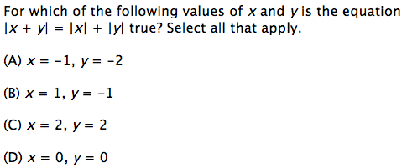
Items are designed to address the aspect(s) of rigor (conceptual understanding, procedural skill, and application) evident in the language of the content standards.
7.NS.A.1 Apply and extend previous understandings of addition and subtraction to add and subtract rational numbers; represent addition and subtraction on a horizontal or vertical number line diagram.
Notes:
© Item adapted from the Smarter Balanced Grade 7 Claim 1 Item Specifications. Available from http://www.smarterbalanced.org/assessments/; accessed April 2016.
Let’s look at this example item written to illustrate Alignment Principle 2.
Answer key: A, C, D
What makes this item a good illustration of Alignment Principle 2?
This work extends the previous work that students did with the definition of absolute value in grade 6 and situates it in the context of their grade 7 work with operations on rational numbers. Since it specifically targets students’ understanding of the difference between the absolute value of the sum of two rational numbers and the sum of the absolute value of two rational numbers, it is a nice example for showing the conceptual understanding called for by this standard in the NS domain.

Slide 11
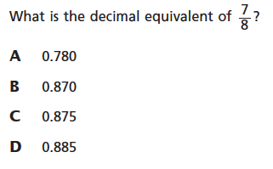
Items are designed to address the aspect(s) of rigor (conceptual understanding, procedural skill, and application) evident in the language of the content standards.
7.NS.A.2d. Convert a rational number to a decimal using long division; know that the decimal form of a rational number terminates in 0s or eventually repeats.
Notes:
© Item retrieved from EngageNY.org of the New York State Education Department. 2015 Grade 7 Mathematics Test Released Questions. Internet. Available from https://www.engageny.org/resource/released-2015-3-8-ela-and-mathematics-state-test-questions; accessed April 15, 2016.
Let’s look at this example item written to illustrate Alignment Principle 2.
Answer key: C
What makes this item a good illustration of Alignment Principle 2?
This item measures the first part of standard 7.NS.2d which explicitly calls for procedural skill in converting a rational number to its decimal equivalent. While this would be better assessed with an equation or numeric entry item type, there may be scoring or other authoring considerations that make multiple choice a more appealing option. In using multiple choice, the answer choices should be carefully constructed to ensure that students are still required to perform the skill articulated by this standard.

Slide 12
Items are designed to address the aspect(s) of rigor (conceptual understanding, procedural skill, and application) evident in the language of the content standards.
7.EE.B.3 Solve multi-step real-life and mathematical problems posed with positive and negative rational numbers in any form (whole numbers, fractions, and decimals), using tools strategically. Apply properties of operations to calculate with numbers in any form; convert between forms as appropriate; and assess the reasonableness of answers using mental computation and estimation strategies.
Notes:
© Item retrieved from the PARCC Grade 7 EOY Test. Available from https://prc.parcconline.org/assessments/parcc-released-items; accessed April 2016.
Let’s look at this example item written to illustrate Alignment Principle 2.
Answer key: 10
What makes this item a good illustration of Alignment Principle 2?
Standard 7.EE.B.3 is clearly about application and ripe for rich problems drawing heavily on students’ work across several years with the rational number system.

Slide 13
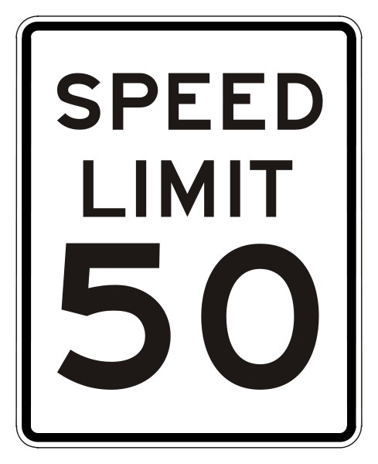
Alignment Principle #3
Items are designed to attend to content limits articulated in the standards.
Notes:
Content limits are often established at the grade level, so it is essential that item writers know and understand the content standards for the entire grade level, not just a single standard for which they may be authoring items. Operations & Algebraic Thinking, Number & Operations in Base Ten, and Number & Operations – Fractions domains all have specific content limits that must be attended to even in items where the direct target of measurement is in a different domain. For example, if students are solving two-step word problems using the four operations in grade 3, and one of the steps happens to be addition, it is important to pay attention to the ceiling established in NBT for addition even though the item will be aligned to the standard in OA.

Slide 14
Items are designed to attend to content limits articulated in the standards.
Linda has $26. She earns $6 for each hour of babysitting. She wants to buy a ski pass for $80.
Enter the minimum number of hours Linda must babysit to be able to buy the ski pass.
Linda has $26. She earns $6 for each hour of babysitting.
Write an equation for t, the total amount of money Linda has after babysitting for h hours.
7.EE.B.4.a. Solve word problems leading to equations of the form px+q=r and p(x+q)=r, where p, q, and r are specific rational numbers. Solve equations of these forms fluently. Compare an algebraic solution to an arithmetic solution, identifying the sequence of operations used in each approach.
Notes:
Let’s look at this example item written to illustrate Alignment Principle 3.
Answer key: t=26+8h; 9 hours
What makes this item a good illustration of Alignment Principle 3?
The grade 7 standards for the EE domain are limited to writing and solving equations in one variable. The problem on the left violates this content limit by asking for students to create an equation in two variables, and therefore would be better posed in grade 8 when students spend more time working with equations in two variables and where “functions” arise as a new domain of study. While there may be cases where students see assessment questions with equations in more than one variable in grade 7, these should be limited to cases where students are using substitution or items that specifically target mathematical reasoning (see for example, slide 13).

Slide 15
Alignment Principle #4
Most items aligned to a single content standard should assess the central concern of the standard.
Notes:
Covering the “breadth” of a standard has often meant attending to every noun, verb, and strategy articulated in the standard and breaking it down into very fine-grained, measurable outcomes. So it is common for item authors to look at the “e.g.” portion of the standard and write items that measure each example given. Often these examples illustrate strategies that are useful as part of teaching and learning to help students become mathematically proficient. Items should be designed in such a way that make certain strategies more efficient and/or appealing when such strategies are articulated. However, summative assessments are designed to measure what students have learned and less how they learned it; therefore, we want the items to measure the core desired outcome of the standard, not merely emphasize the choice of strategy.

Slide 16
Most items aligned to a single content standard should assess the central concern of the standard.
Central Concern
Not the Central Concern
For each set of 3 lengths given, select YES or NO to tell whether they could be the side lengths of a triangle.
Use the line segment tool to create a regular hexagon in the space provided. You may use the ruler and/or protractor tools as needed.
Lengths | YES | NO
5 cm, 4 cm, 3 cm
7 cm, 5 cm, 1 cm
12 cm, 6 cm, 6 cm
7.G.A.2 Draw (freehand, with ruler and protractor, and with technology) geometric shapes with given conditions. Focus on constructing triangles from three measures of angles or sides, noticing when the conditions determine a unique triangle, more than one triangle, or no triangle.
Notes:
Let’s look at this example item written to illustrate Alignment Principle 4.
Answer key: Y, N, N; Student creates the figure as described
What makes this item a good illustration of Alignment Principle 4?
While the item shown on the right technically matches the language of the first sentence of the standard, it is not the central concern of the standard. In this particular standard, 7.G.A.2, there is actually a second sentence that uses the phrase “focus on..” giving item authors specific language on what the central concern of this standard should be. So most items aligned to 7.G.A.2 should support students’ understanding of when specific conditions determine a unique triangle, more than one triangle or no triangle.

Slide 17
Alignment Principle #5
Representations are well suited to the mathematics that students are learning and serve an important purpose within the item itself.
Notes:
Representations, such as number lines and area models, should be well connected to the mathematics that students are learning and serve an important purpose within the item itself.
When developing an item an item writer should ask: “Is there something mathematically important about including this representation?” If the answer is “Yes,” then the item writer should proceed. The next question the item writer must ask when developing an item should be: “Is the representation giving the appearance of a particular solution path even though other strategies are viable and likely?” The answer to this question should be “No.” Answering these questions will help an item writer decide whether to include a particular representation.

Slide 18
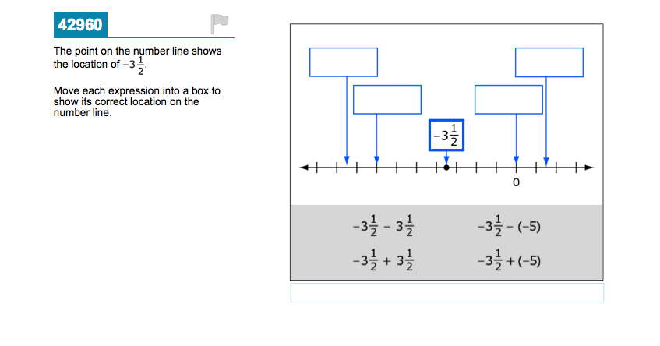
Representations are well suited to the mathematics that students are learning and serve an important purpose within the item itself.
7.NS.A.1 Apply and extend previous understandings of addition and subtraction to add and subtract rational numbers; represent addition and subtraction on a horizontal or vertical number line diagram.
Notes:
© Item retrieved from the Smarter Balanced Grade 7 Sample Items. Available from http://www.smarterbalanced.org/assessments/; accessed April 2016.
Let’s look at this example item written to illustrate Alignment Principle 5.
Answer key: Student drags each expression to the correct location
What makes this item a good illustration of Alignment Principle 5?
The number line is consistently used as a representation to support students' understanding of the value of numbers and/or expressions. This is particularly important given the careful progression built across grades as the subset of the number system that students work with regularly grows in size from year to year. In grade 7, as in earlier grades, the number line can support students not just in understanding the value of an expression, but also in understanding the meaning of the operations they are using, allowing them to connect to prior work with operations on whole numbers, then fractions, and eventually by grade 7, the system of rational numbers.
As noted in some other places, drag-and-drop items should be used sparingly as required by the construct or particular purpose of an item as this format is not accessible to all students currently. Assessment delivery platform designers are making strides in finding other more accessible ways to measure some of these things consistent with good uses of drag-and-drop like the one here. We look forward to more progress in this area!

Slide 19
Alignment Principle #6
Items use mathematically precise language, are free from mathematical errors or ambiguities, and are aligned to the mathematically appropriate standard.
Notes:
This alignment principle covers a range of issues related to the mathematical and technical quality of items, from using “least” instead of “fewest,” to failing to adequately specify what is meant by “one cubic unit” in a visual image. This is one of the more challenging aspects to train writers and reviewers on due to the type of specific content knowledge needed to successfully identify issues. Incorporating mathematicians into review processes for at least a subset of the total development can provide some assurance that this principle is being well attended to by item authors and/or reviewers.

Slide 20
Items use mathematically precise language, are free from mathematical errors or ambiguities, and are aligned to the mathematically appropriate standard.
✗
Jorge has $50. He works for x number of hours and makes $20 per hour. Write an equation that can be solved to find the number of hours he needs to work to have a total of $310.
✔
Jorge has $50. He works for x hours and makes $20 per hour. Write an equation that can be solved to find the number of hours he needs to work to have a total of $310.
6.RP.A.3 Use ratio and rate reasoning to solve real-world and mathematical problems, e.g., by reasoning about tables of equivalent ratios, tape diagrams, double number line diagrams, or equations.
Notes:
Let’s look at this example item written to illustrate Alignment Principle 6.
Answer key: 13
What makes this item a good illustration of Alignment Principle 6?
It is very common to see issues with correctly assigning a variable to the quantity it represents. In this particular example, the incorrect version uses the phrase “x number of hours.” Given that the variable represents an unknown number, this is like saying “He works for 13 number of hours.” Reviewers should very carefully check items that use variables to represent unknown quantities or quantities that change for mathematical correctness. Having consistent language for authors to use can help reduce the frequency of these kinds of errors.

Slide 21
Alignment Principle #7
The demands of items measuring the Standards for Mathematical Practice are appropriate to the targeted grade level.
Notes:
The Standards for Mathematical Practice should reflect a growing arc of sophistication in assessment items. In early grades, students might give examples or non-examples to show their understanding of a particular claim, but are not asked to prove it or show that it is true for all cases. Similarly, younger students begin modeling real-world situations with equations, but do not engage in the full modeling cycle shown in the high school standards.

Slide 22
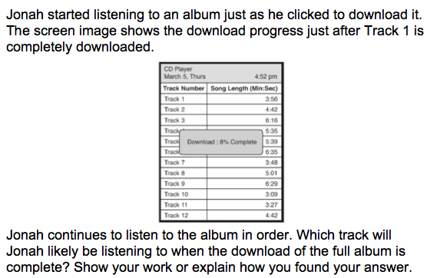
The demands of items measuring the Standards for Mathematical Practice are appropriate to the targeted grade level.
MP4. Model with mathematics.
7.RP.A.3. Use proportional relationships to solve multistep ratio and percent problems.
Notes:
Let’s look at this example item written to illustrate Alignment Principle 7.
Answer key: Depending on the specific assumptions that students make here, either Track 10 or Track 11 with sufficient reasoning to support the answer
What makes this item a good illustration of Alignment Principle 7?
As students progress through the grade levels, they should see more and more problems where they are expected to make certain assumptions as part of the problem-solving process. Including modeling expectations in assessments prepares students for the reality that not all mathematics problems contain exactly the information needed to solve the problem, but that problems in the real world often are missing information or contain more information than needed. In this particular problem, one assumption that students may make is that percent of download completion with respect to time is approximately linear. Depending on their approach, students may have slightly different answers about the likely track that Jonah will be listening to. A range of plausible answers with a reasonable error band is a common feature of problems that target MP4, particularly in later grades.

Slide 23
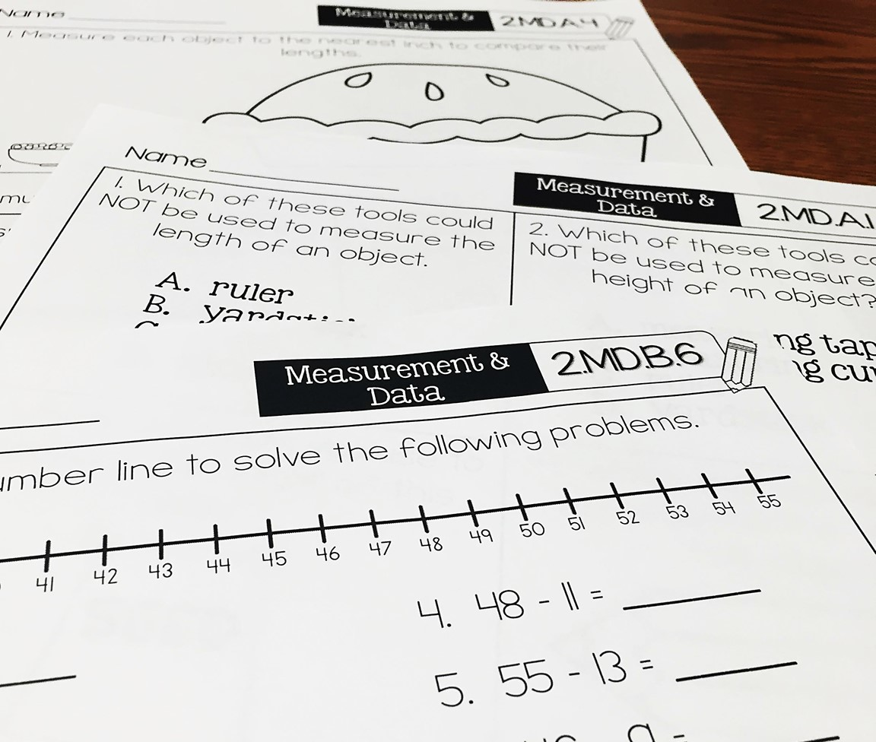
Alignment Principle #8
Item types are chosen to match the item’s purpose and as part of the evidence required by the standards.
Notes:
With many assessments moving online, choices of item type have a lot of driving factors: accessibility, cost, and content. In this section, we will show examples of items that are designed well to meet the evidence required by the standards and are well suited to a particular item’s purpose. This is not to say that a balanced assessment that meets the demands of the standards must include all of these item types nor that this is an exhaustive list of available item types, but that an aligned assessment will include multiple item types. These are illustrations of good ways to collect the evidence required by the standards, but decisions ultimately must be made after carefully considering how to effectively balance cost, content, and accessibility.

Slide 24
Item types are chosen to match the item’s purpose and as part of the evidence required by the standards.
For each row, click the box that correctly compares the values of A and B.
A | B | A > B | A < B | A = B
7.NS.A.1 Apply and extend previous understandings of addition and subtraction to add and subtract rational numbers; represent addition and subtraction on a horizontal or vertical number line diagram.
Notes:
Let’s look at this example item written to illustrate Alignment Principle 8.
Answer key: A>B; A<B; A<B
What makes this item a good illustration of Alignment Principle 8?
The selection table is valuable here where we want students using the meaning of operations and looking closely at the numbers within each expression. In all cases, students can select the correct comparison without actually performing any computations.

Slide 25
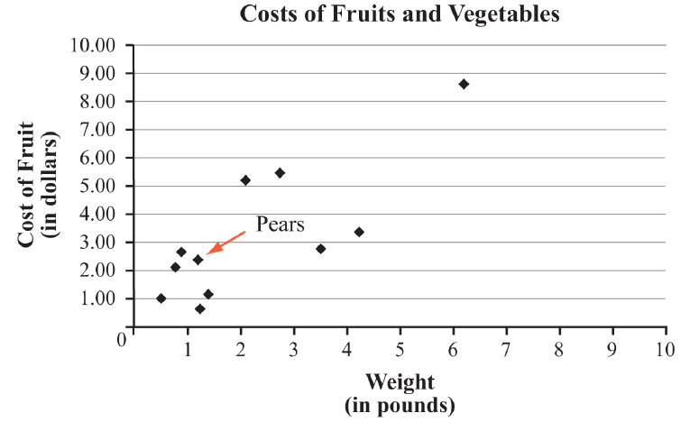
Item types are chosen to match the item’s purpose and as part of the evidence required by the standards.
The graph shows the weights and costs of the fruits and vegetables Tyrus bought at the store. For example, Tyrus bought 1.2 pounds of pears for $2.39.
Click on the graph to select all points with a higher cost per pound than the pears.
7.RP.2. Recognize and represent proportional relationships between quantities.
d. Explain what a point (x, y) on the graph of a proportional relationship means in terms of the situation, with special attention to the points (0, 0) and (1, r) where r is the unit rate
Notes:
Let’s look at this example item written to illustrate Alignment Principle 8.
Answer key: Student selects the correct 3 points
What makes this item a good illustration of Alignment Principle 8?
Using hotspot is a good choice when students need to select specific objects on a graph or diagram to indicate their response. In grade 7, students examine graphical representations of proportional relationships and relate the meaning of the coordinates of a particular point to the situation.

Slide 26
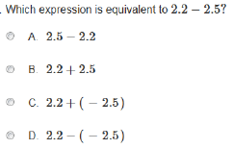
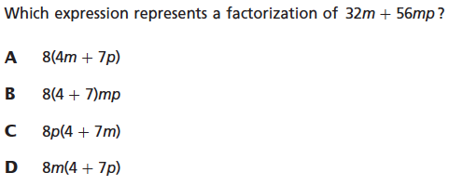
Item types are chosen to match the item’s purpose and as part of the evidence required by the standards.
7.NS.A.1.c. Understand subtraction of rational numbers as adding the additive inverse, p – q = p + (–q). Show that the distance between two rational numbers on the number line is the absolute value of their difference, and apply this principle in real-world contexts.
7.EE.A.1. Apply properties of operations as strategies to add, subtract, factor, and expand linear expressions with rational coefficients.
Notes:
© Item retrieved from the PARCC Grade 7 EOY Test. Available from https://prc.parcconline.org/assessments/parcc-released-items; accessed April 2016.
Let’s look at this example item written to illustrate Alignment Principle 8.
Answer key: C; D
What makes this item a good illustration of Alignment Principle 8?
Multiple choice can be valuable where the form of an expression is an important part of what the item is measuring, and therefore is generally useful when measuring students’ ability to identify an expression equivalent to a given expression. In this case on the left, the question is explicitly targeting whether the student understands subtraction as the additive inverse and so it is reasonable that the student selects from a list versus creating the expression. On the right, students are asked to select a factorization of the given expression.

Slide 27
Alignment Principle #9
Most items measuring the Standards for Mathematical Practice are also aligned to content standards representing the major work of the grade.
Notes:
Keeping the assessment focused on the major work of the grade is an important design principle in the overall test construction. In measuring the Standards for Mathematical Practice, it is important to help retain the focus of the test by using many items that align to the major work of the grade.

Slide 28
Most items measuring the Standards for Mathematical Practice are also aligned to content standards representing the major work of the grade.
MP4. Model with mathematics.
7.RP.A. Analyze proportional relationships and use them to solve real-world and mathematical problems.
Notes:
© Item adapted from the Smarter Balanced Grade 7 Claim 4 Item Specifications. Available from http://www.smarterbalanced.org/assessments/; accessed April 2016.
Let’s look at this example item written to illustrate Alignment Principle 9.
Answer key: A, C
What makes this item a good illustration of Alignment Principle 9?
While this problem could have given more information in the item stem and then simply asked “what is the height of the 50th step,” it is aligned to MP4 and designed to help students grapple with mathematics problems that are more consistent with the real world where additional information is needed or assumptions must be made to formulate a response. By connecting to the content of the RP domain, the item reflects the stated principle and uses major work of the grade to strengthen students’ engagement with the Standards for Mathematical Practice.
Many assessment programs will choose a format for multi-select items that differs from its multiple choice. For example, they might use check boxes instead of letters for answer options or not allow for four answer choices. Since this module is primarily focused on alignment, we have elected to keep the item format as it was in the specific assessment program’s documentation.

Slide 29
Alignment Principle #10
Items written at the cluster or domain level measure key integration points not necessarily articulated in individual standards but plausibly implied directly by what is written.
Notes:
A few items per test event may serve as opportunities to connect content across standards, domains, or grade levels. These opportunities should be carefully defined with an established purpose tied back to the language and structure of the standards. An item writer might ask: What key connections are students being asked to make to respond to this question that isn’t articulated in any individual standard?

Slide 30
Items written at the cluster or domain level measure key integration points not necessarily articulated in individual standards but plausibly implied directly by what is written.
7.RP.A Analyze proportional relationships and use them to solve real-world and mathematical problems.
Notes:
© Item adapted from the Smarter Balanced Grade 7 Claim 3 Item Specifications. Available from http://www.smarterbalanced.org/assessments/; accessed April 2016.
Let’s look at this example item written to illustrate Alignment Principle 10.
Answer key: Part A: n/t; t/n; Part B: C
What makes this item a good illustration of Alignment Principle 10?
Only the cluster level of the grade 7 RP domain uses the phrase “Analyze proportional relationships.” This item doesn’t directly align to any individual standard within the domain; however, because this item requires thoughtful analysis of the relationship between speed and pace, it supports the more global understanding of proportional relationships articulated in the language of the cluster heading.
For some assessment development and delivery platforms, this item might have to be structured differently to be delivered to students. For example, the first two questions might have to be multiple choice also (e.g., by listing t/n, n/t, t*n, and one other option for both questions). For a paper-pencil test, the questions could be delivered as they are. Other innovations in test delivery may also support delivery of the question as designed here.

Slide 31
Ten Principles of CCSS-Aligned Items
1. Most items aligned to standards in supporting clusters connect to the major work of the grade.
2. Items are designed to address the aspect(s) of rigor (conceptual understanding, procedural skill, and application) evident in the language of the content standards.
3. Items are designed to attend to content limits articulated in the standards.
4. Most items aligned to a single content standard should assess the central concern of the standard.
5. Representations are well suited to the mathematics that students are learning and serve an important purpose within the item itself.
6. Items use mathematically precise language, are free from mathematical errors or ambiguities, and are aligned to the mathematically appropriate standard.
7. The demands of items measuring the Standards for Mathematical Practice are appropriate to the targeted grade level.
8. Item types are chosen to match the item’s purpose and as part of the evidence required by the standards.
9. Most items measuring the Standards for Mathematical Practice are also aligned to content standards representing the major work of the grade.
10. Items written at the cluster or domain level measure key integration points not necessarily articulated in individual standards but plausibly implied directly by what is written.
Notes:
The principles illustrated throughout this module are intended to support those charged with developing summative mathematics assessment items and to support training efforts for those who review the content of items.

Slide 32
Thank You!

