Slide 1
Disrupting the Canon: Moving Towards Anti-Racist Teaching with Text Selection and Preparation
Core Advocates Monthly Webinar
September 23, 2020
Notes:
Pascale
First timer poll
Handouts:
While we’re waiting, we’d like you to participate in a quick poll so we can get an understanding of who’s on the webinar with us tonight.

Slide 2

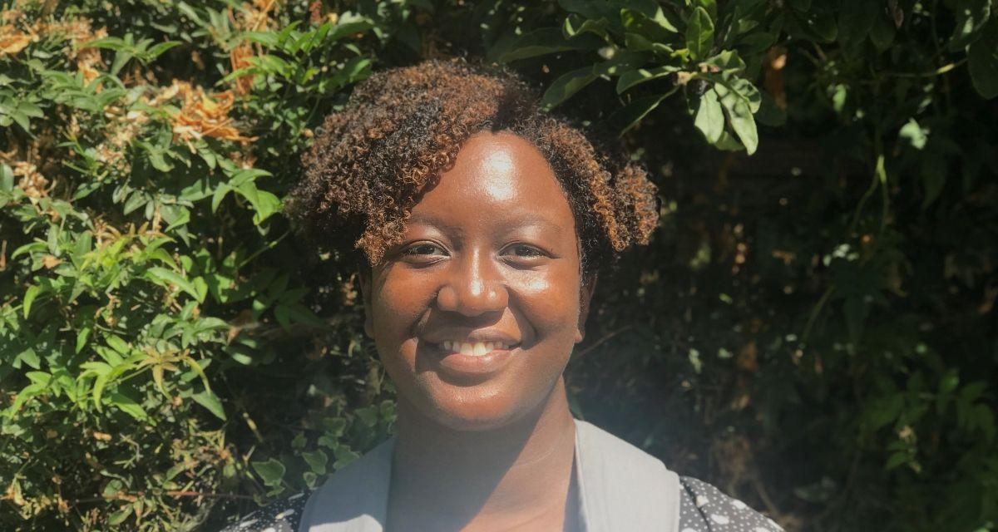

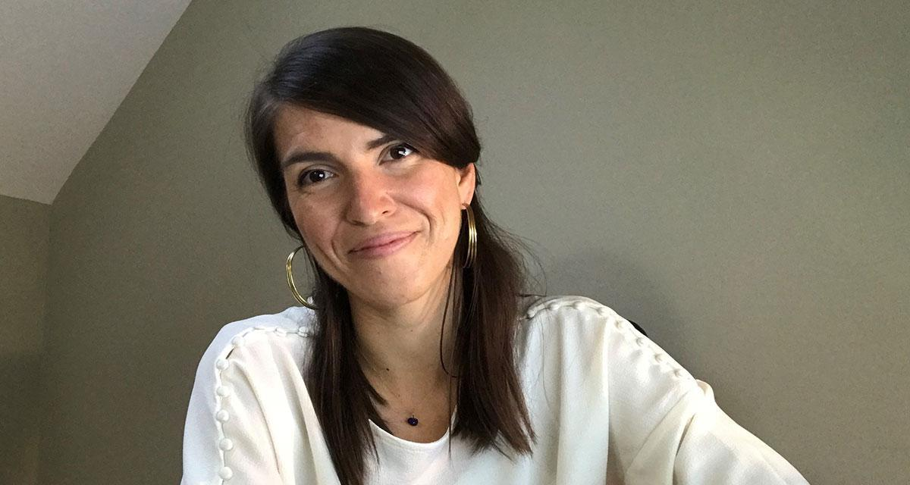
Introductions
Your hosts from Student Achievement Partners:
Pascale Joseph
Project Coordinator,
Tools and Classroom Resources, SAP
This month’s presenters:
Joy Delizo-Osborne
Program Manager
Professional Learning, SAP
Kate Crist
ELA/Literacy Specialist
Professional Learning, SAP
Tori Filler
ELA/Literacy Specialist
Professional Learning, SAP

Slide 3
Did you attend last week’s Coffee and Conversations event with Disrupt Texts co-founder, Lorena German?
Please use the Questions tab on your control panel to respond.
.
Notes:
Yes/No
(Lisa suggested this as a way to quickly capture info on a question I have been wondering about- how well our related topic offerings ‘funnel’ engagement to each other.)

Slide 4

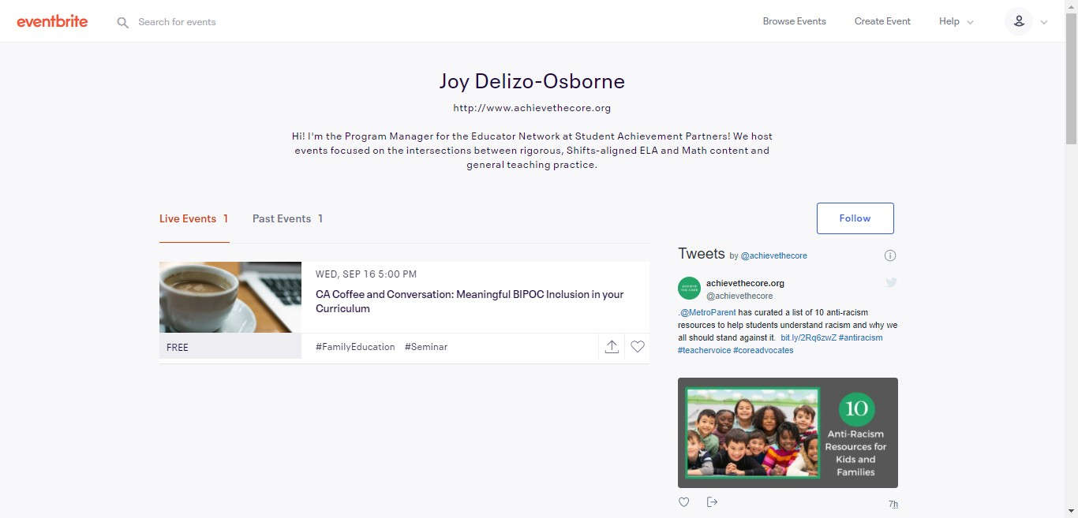
Upcoming Coffee & Conversation Events!
All events take place at 7 p.m. ET.
10/14: Supporting Undocumented Students and Families
Guest: Vanessa Luna, ImmSchools
10/21: Students Want a Say in the Anti-Racist Teaching Conversation
Guests: Student Activists with #diversifyournarrative
11/4: Supporting LGBTQ+ Students
Guest: Becca Mui, GLSEN
Follow us on Eventbrite! CoreAdvocates.Eventbrite.com
Notes:
Pascale

Slide 5
Goals of the Webinar
Share our emerging thinking about the intersection of shifts-aligned, text-first planning and the four pillars for disrupting texts
Discuss upcoming opportunities to learn together
Get input on what you’d like to see and how you’d like to engage moving forward
Notes:
Switch to Tori/Rachel/Kate/Joy
We have three main goals for our webinar tonight. They are to...

Slide 6
Overview
Notes:
Kate → slide 12

Slide 7

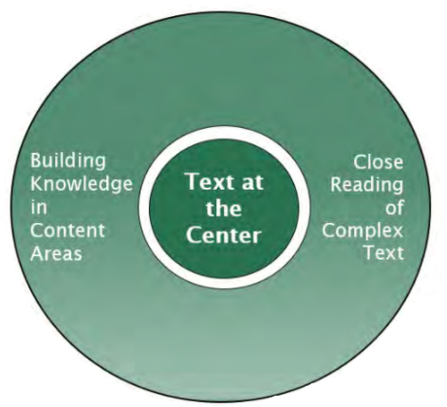
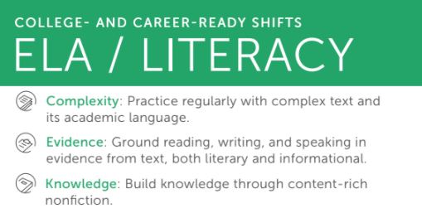
SAP’s Previous Work
with Texts
Chat:
What were you taught in your teacher preparation program or professional development about what really matters in text selection and preparation?
Notes:
Kate
Chat
A bit about SAP’s past work:
Most of our work here at SAP has centered on a couple of big ideas in ELA/literacy instruction.
One, is the Shifts. These are the big instructional practices that make college- and career-ready standards come to life. And, these were named as “shifts” because for many of us nationally, they represented big changes about how we teach. These shifts are 1) Use of grade-level complex text with all students; 2) Grounding our work in evidence from the text; and 3) Building knowledge through content-rich nonfiction and topical study. Some of those big ideas likely sound familiar to you as you think about your work over the past couple of years, or some priorities in your instruction right now.
At SAP, we’ve also worked to talk about keeping “text at the center.” Text at the center looks like reading, writing, speaking & listening grounded in rich, grade-level text. The knowledge and ideas in these complex texts are at the center, at the heart, of our work. Text at the center doesn’t look like leading with isolated standards, skills, and strategies.
These research based ideas are still important ones. And we know that these things remain important pieces of equitable ELA/literacy instruction for all students. But, they aren’t everything…

Slide 8




This collaborative’s question about texts:
How can we disrupt the canon and move towards anti-racist teaching, as we keep complex text at the center of instruction?
Notes:
Kate
We question: How we can disrupt the canon and move towards more anti-racist teaching practices, while keeping complex text at the center of instruction?
Disrupting the canon means interrogating the texts that we teach and how we chose to teach them. You see some texts on the screen that have been part of the “canon” across K-12 -- texts that have historically been commonly taught in schools...and texts that often center whiteness. Last week during our Coffee & Conversations talk with LORENA GERMÁN from #DisruptTexts, which you’ll hear about in just a bit, she talked with us about questioning books in the canon that are sometimes thought of as providing more diverse perspectives like To Kill a Mockingbird. In her words, “if you’re using To Kill a Mockingbird and not talking about white saviorism, that’s a mistake.”
Are there any other books you can think of as part of the K-12 literary canon that center whiteness? Leave them in the chat.
Other examples of canonical texts from #Disrupt Texts:
1984
The Adventures of Huckleberry Finn
Catcher in the Rye
The Crucible
The Great Gatsby
Hamlet
Julius Caesar
Lord of the Flies
MacBeth
Of Mice and Men
Othello
Romeo and Juliet
The Scarlet Letter
Their Eyes Were Watching God
To Kill a Mockingbird
The Tempest

Slide 9

Exploring this
question
together...
Your insights, your experiences, and your students are the why behind our work. Let’s build a new model for learning community together.
Notes:
Kate
We believe that we can’t do this work in a vacuum.
And so today we’re asking whether you might want to explore this question together.
We believe that we can’t do this work in a vacuum.
Your insights, your experiences, and your students are the why behind our work. Let’s build a new model for learning community together.

Slide 10
How familiar are you with the #DisruptTexts movement?
Notes:
Kate
Choose one:
Very familiar
Somewhat familiar
Not familiar at all

Slide 11
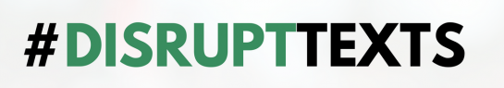
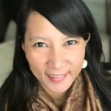



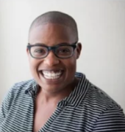

TRICIA EBARVIA
LORENA GERMÁN
“Disrupt Texts is a crowdsourced, grass roots effort by teachers for teachers to challenge the traditional canon in order to create a more inclusive, representative, and equitable language arts curriculum that our students deserve. It is part of our mission to aid and develop teachers committed to anti-racist/anti-bias teaching pedagogy and practices.”
@DisruptTexts
disrupttexts.org
DR. KIMBERLY N. PARKER
JULIA E. TORRES
Notes:
Joy
https://disrupttexts.org/

Slide 12

Four Key Values of Disrupt Texts:
bit.ly/DisruptTextPillars
Continuously interrogate our own biases to understand how they inform our teaching
Center Black, Indigenous, and voices of color in literature
Apply a critical literacy lens to our teaching practices
Work in community with others, especially BIPOC
Pillar #1
Pillar #2
Pillar #3
Pillar #4
Notes:
Joy
Skim/scan for 2 minutes
Source: https://www.kqed.org/mindshift/55039/how-the-disrupttexts-movement-can-help-english-teachers-be-more-inclusive

Slide 13

Pillar #1: Interrogating Our Own Biases
“Folks tend to skip over the necessary stage of interrogating themselves before jumping into diverse texts.”
Julia Torres
#DisruptTexts founder and teacher-librarian in Colorado
Chat:
What is a book that stands out to you from your own childhood or teaching career?
Whose voice is centered in that book (characters, authorship, illustrations)? How does this relate to your own identity and experiences?
Notes:
Joy
Here at SAP we’re thinking about how important it is to start at the very beginning. One of the ways we’re thinking about that is by starting with ourselves. Pillar #1 is about interrogating our own biases.
Torres explained that a core part of this work is recognizing that every text has a particular perspective and was written at a particular time. That’s not necessarily good or bad, but teachers must recognize that context, and help students to interrogate what it could mean for the text.
Quote from: https://www.kqed.org/mindshift/55039/how-the-disrupttexts-movement-can-help-english-teachers-be-more-inclusive

Slide 14
“We must reject the notion that being community-centered and building learning communities that honor and affirm the identities of our students and families comes at the expense of academic rigor. We must equally reject the notion that increasing the quality of curriculum, and asking educators to deepen their content knowledge along the way, diminishes the culture and community-feeling of school.
Binary thinking is overly simplistic and ignores complexities of what schools are and should be.”
-Mia Howard, The Opportunity Trust

Slide 15
You Are Invited!
How do we move from discussion to action? How do we, as educators, begin to practice showing up as anti-racist educators in our classrooms? How do we responsibly begin (or continue to) center the work of BIPOC writers in our curricula?
The team at SAP wants to lean into learning more about how to hold these questions alongside the rigor expected in the Shifts, and we want to do that learning with you.
You Are Invited!
Notes:
kate → 18
So - let’s do this together!

Slide 16

Sample Session Structure
Session
Applying a Critical Literacy Lens to our Practice (Pillar #3)
Guiding Question(s)
What lenses do we need to bring to the texts we teach our students?
How do we begin to internalize the understanding that all texts are ‘about race’ and other aspects of identity?
How does our planning account for this critical lens and engage students to develop their understanding?
Sample Agenda:
Begin with your community (Pillar 4)
Discussion Groups on theory-based pre-reading
Sample critical text analysis of a BIPOC-focused text
Reflection discussion groups
Aha, Appreciation, Apology protocol
In each hour-long Zoom session, participants will engage directly with one another. Certificates will be available for professional learning hours.
Notes:
Kate

Slide 17
What’s Next?

Slide 18
Tell us what works!
Weekly Series: October 12th-30th
*Specific dates and times to be finalized based on your input!
October 2020
Sun. | Mon. | Tues. | Wed. | Thurs. | Fri. | Sat.
 |  |  |  | 1 | 2 | 3
4 | 5 | 6 | 7 | 8 | 9 | 10
11 | 12 | 13 | 14 | 15 | 16 | 17
18 | 19 | 20 | 21 | 22 | 23 | 24
25 | 26 | 27 | 28 | 29 | 30 | 31
Please complete the survey with your meeting preferences and your name will be added to our interest list.
http://bit.ly/SeminarTiming
Notes:
Joy

Slide 19
Questions?

Slide 20
Please Join Us Again Next Month!
Next month’s webinar:
The Early Reading Accelerators
Thursday October 8, 2020 @7pm
Register Here:
https://event.on24.com/wcc/r/2628843/B691457FC052821ACA270072CFF2A7B4

Slide 21
Resource Name | Link
“How the #DisruptTexts Movement Can Help English Teachers Be More Inclusive” by Katrina Schwartz | bit.ly/DisruptTextPillars
Disrupt Texts | https://disrupttexts.org/
Upcoming Coffee and Conversations Events | http://CoreAdvocates.Eventbrite.Com
Session Follow-Up Survey: Add Your Name to the Interest List! | http://bit.ly/SeminarTiming
Register for the Next Webinar: The Early Reading Accelerators Thursday October 8, 2020 @7pm | https://event.on24.com/wcc/r/2628843/B691457FC052821ACA270072CFF2A7B4

Slide 22


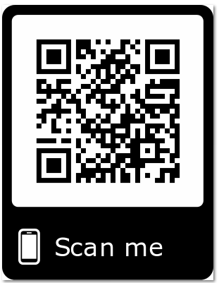


Please Join Us!
https://achievethecore.org/ca-signup
Twitter: twitter.com/achievethecore
Facebook: facebook.com/achievethecore
Pinterest: pinterest.com/achievethecore
Notes:
We encourage you to join the network by filling out this survey completely at atc.org/ca-signup

Slide 23
Thank You!

